Slide 1

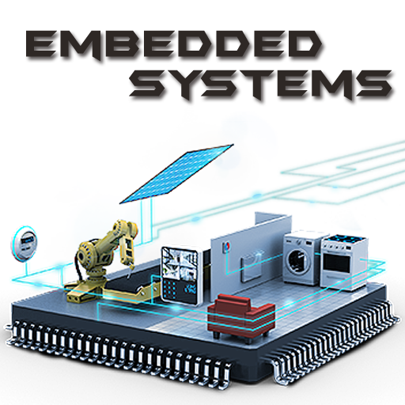
Graduation project electric water heater
Presented by:
ENG/Khaled mostafa
ENG/Amr zakarya
ENG/Mahmoud ahmed mohamed
ENG/Banykur william

Slide 2
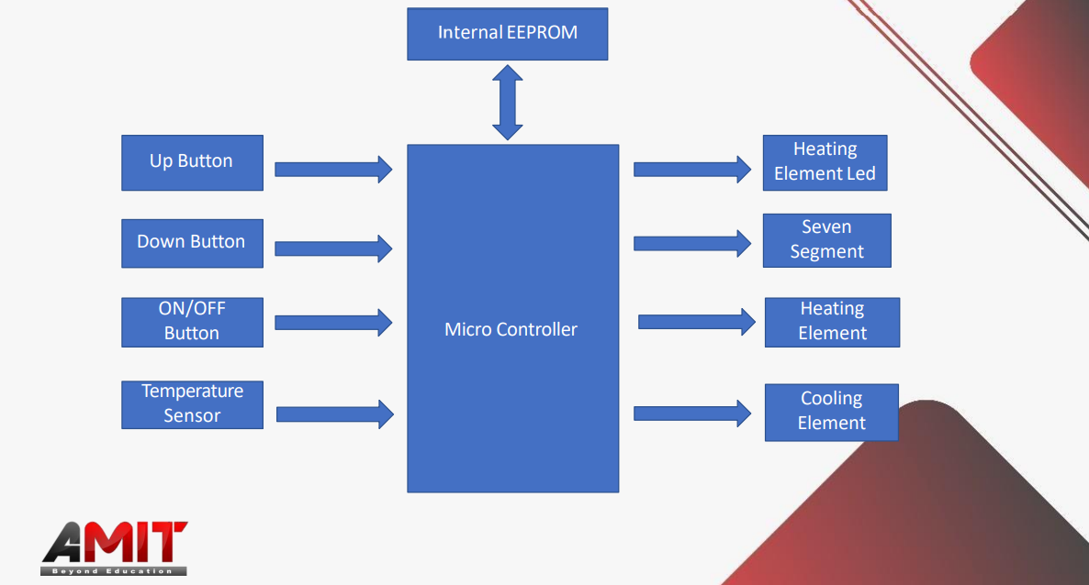
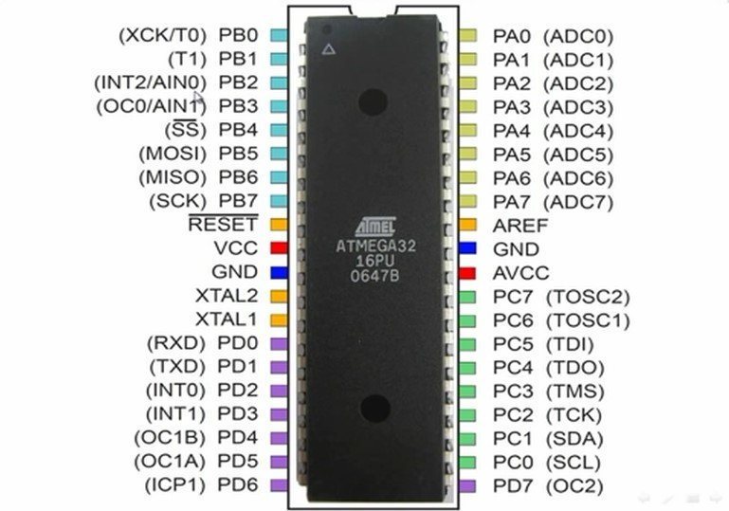
Introduction
COMPONENTS
MICROCONTROLLER (ATMEGA32)

Slide 3
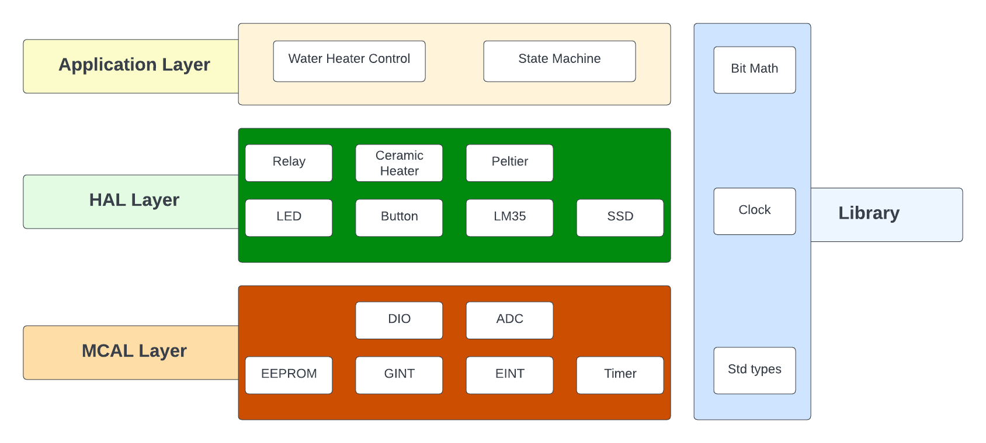
LAYERED ARCHITECTURE

Slide 4
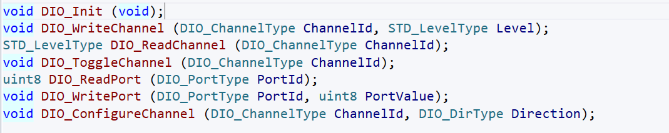
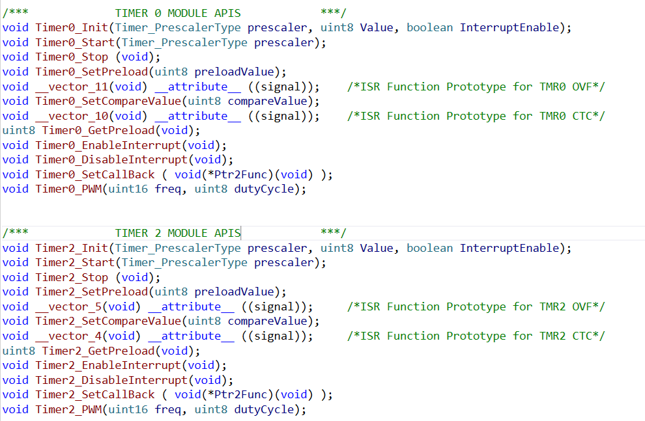



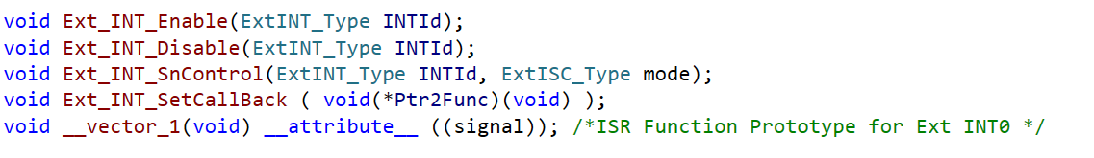
Modules api specification – Microcontroller abstraction layer
DIO: • Timer:
ADC:
EEPROM: • GINT:
• EINT:

Slide 5


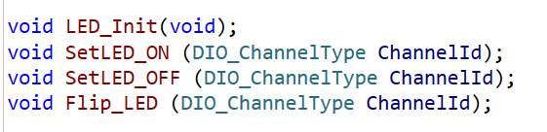


Modules api specification – HARDWARE abstraction layer
Button: LM35:
LED: Ceramic Heater:
SSD: Peltier:
Relay:

Slide 6

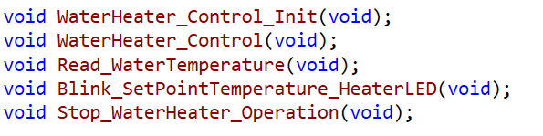
Modules api specification – application layer
STATE MACHINE:
WATER HEATER CONTROL:

Slide 7
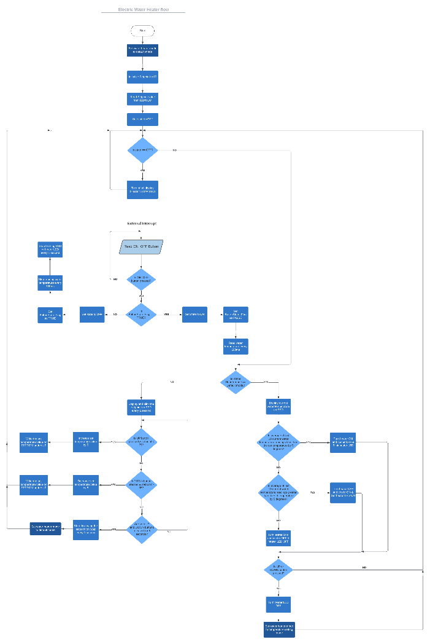
Operating flow chart Diagram

Slide 8
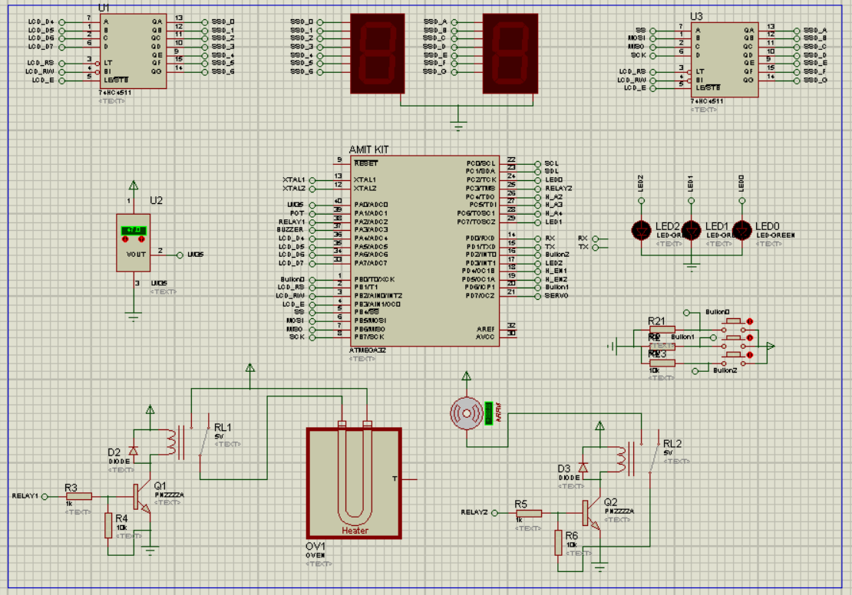
project LAYOUT

Slide 9
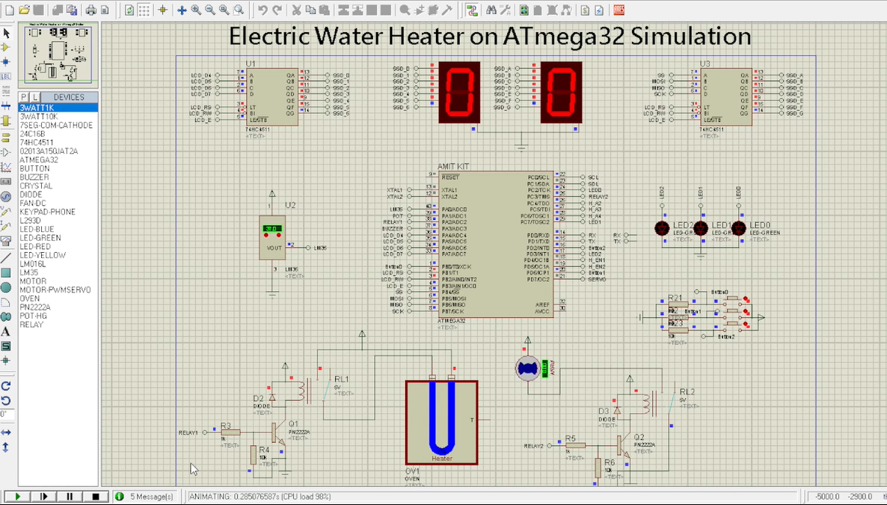
SIMULATION

Slide 10
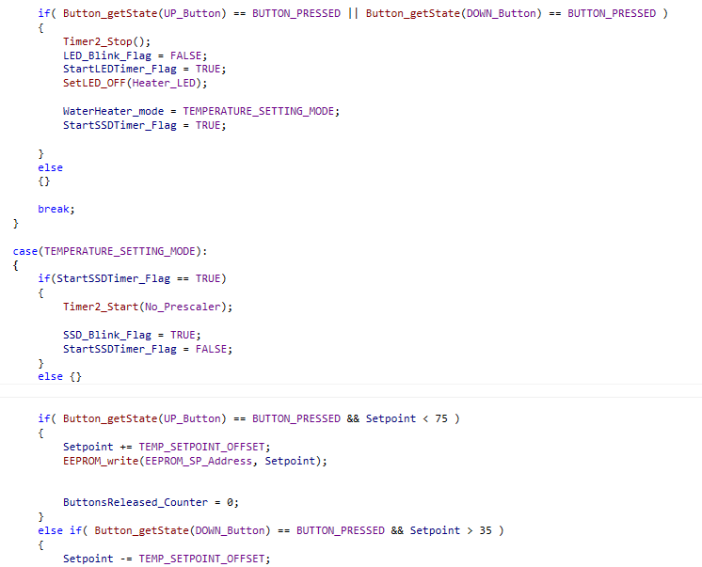
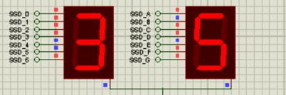
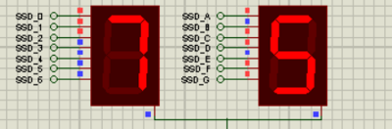
Problems encountered
Button Debouncing and Invalid Set Temperature Modification

Slide 11
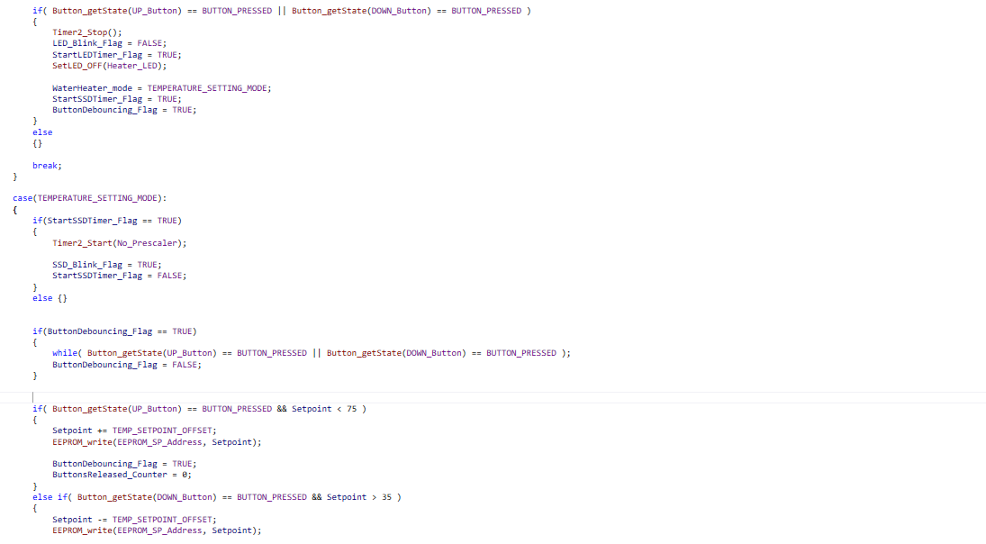
PROBLEM SOLVING
Button Debouncing and Invalid Set Temperature Modification

Slide 12
ANY QUESTIONS…?

Slide 13
THANK YOU!

